Slide 1

DEPI Round Three AI & Data Science Track
Med-RAG System: AI-powered Medical Information Retrieval
Using Retrieval-Augmented Generation (RAG) on 200k+ Medicine Dataset
Presenters
Mohamed Hossam
Ahmed Elbadry
Abdallah Abusalma
Ibrahim Waz
Date: 15/12/2025

Slide 2
Problem Statement: Addressing Medical Information Challenges
The core challenge in the healthcare sector is the immediate and accurate access to critical medication information for both doctors and patients. Professionals and individuals frequently require fast answers to questions regarding a drug's manufacturer company, its ingredients, and crucial side effects, in addition to potential alternatives or equivalent drugs. Traditional methods, such as searching through static search results on Google or fragmented PDF documentation, are often insufficient because they provide fragmented data and lack the contextual reasoning necessary to synthesize a complete and reliable answer. This gap highlights the need for a modern, intelligent system capable of overcoming these limitations and providing synthesized, trustworthy medical responses instantly.
Proposed Solution: RAG architecture → retrieve trusted drug data → generate high-quality, grounded answers.

Slide 3
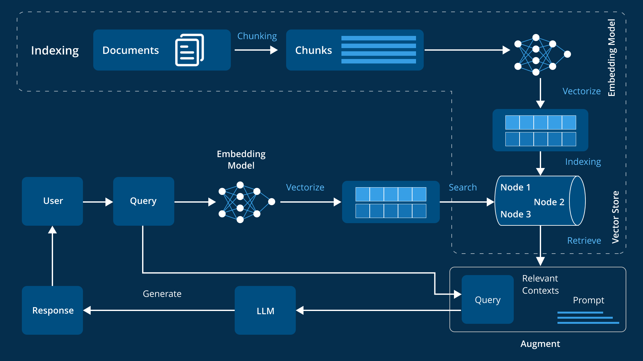
What is RAG? Retrieval–Augmented Generation = LLM + Search over knowledge base

Slide 4
Dataset Foundation
Source: Kaggle — Medicine Datasets https://kaggle.com/datasets/ilyasfaruqui208/medicine-datasets-
Key Specs:
200,000+ unique medicines
8 Feature Columns
Typical columns include:
Drug Name - Sub Category – Manufacturer - Composition
Drug Description - Side Effects – Price - Drug Interactions

Slide 5
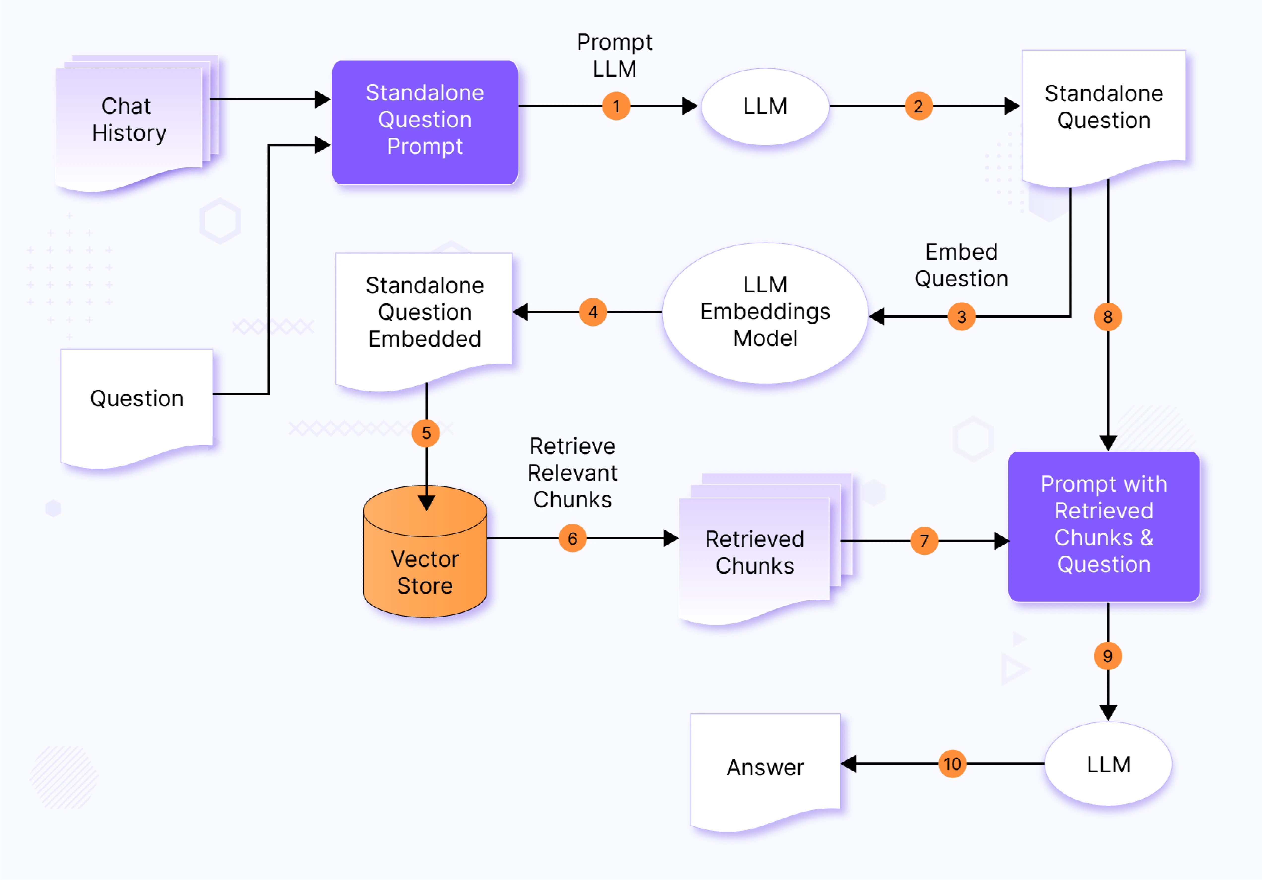
System Architecture (High-Level)

Slide 6
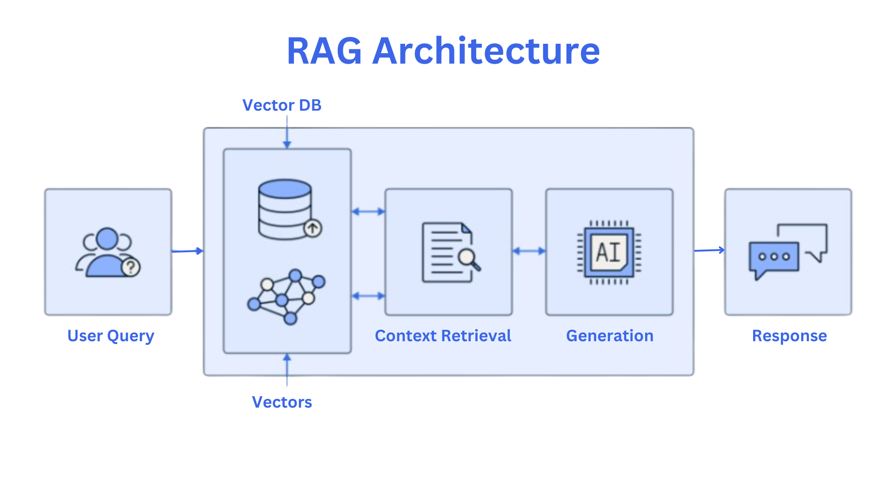

Slide 7
Main Technologies Used in the Medicine RAG System
1- Retrieval-Augmented Generation (RAG) System: Technology Stack
RAG Component | Key Technologies
Data Ingestion | Unstructured, pandas, pypdf, sentence-transformers
Core RAG Engine | chromadb, faiss-cpu, transformers, groq/ollama
Deployment | fastapi, uvicorn

Slide 8
2- Data Processing & Preparation
Component | Technologies | Primary Function
File Ingestion | unstructured, pdfplumber, pypdf, beautifulsoup4 | Extract text from various file formats (PDFs, HTML, etc.).
Data Cleaning & Prep | pandas, numpy, regex | Data manipulation, cleaning (e.g., removing noise, handling missing values), and structuring the Kaggle dataset.
Chunking / Data Split | langchain-text-splitters, langchain-core | Divide long medical documents into smaller, semantically meaningful chunks for efficient retrieval.

Slide 9
3- Vectorization, Storage, & LLM
Component | Technologies | Primary Function
Embedding Generation | sentence-transformers, transformers, huggingface-hub | Convert text chunks and user queries into high-dimensional numerical vector embeddings that capture semantic meaning.
Vector Storage & Retrieval | chromadb, faiss-cpu, langchain-chroma | Store and index millions of vector embeddings. Perform fast similarity search (Nearest Neighbor) to retrieve the most relevant context.
LLM Engine | ollama, langchain-ollama, groq, langchain-groq | Generative Core: Takes the user query and the retrieved context to synthesize the final, fluent, and accurate medical answer.

Slide 10
4- System Deployment & Performance
Component | Technologies | Primary Function
Backend API | fastapi, uvicorn | Create a high-speed, asynchronous API endpoint for user queries. FastAPI provides the structure; Uvicorn is the ASGI server that runs it.
Tokenization | tiktoken | Efficiently manage and count tokens (words/sub-words) for the LLM prompts to control cost and avoid exceeding context limits.
Acceleration / Runtime | accelerate, torch, onnxruntime | Libraries used for optimizing the performance of the large models (LLM and Embeddings) using techniques like quantization and GPU offloading.

Slide 11
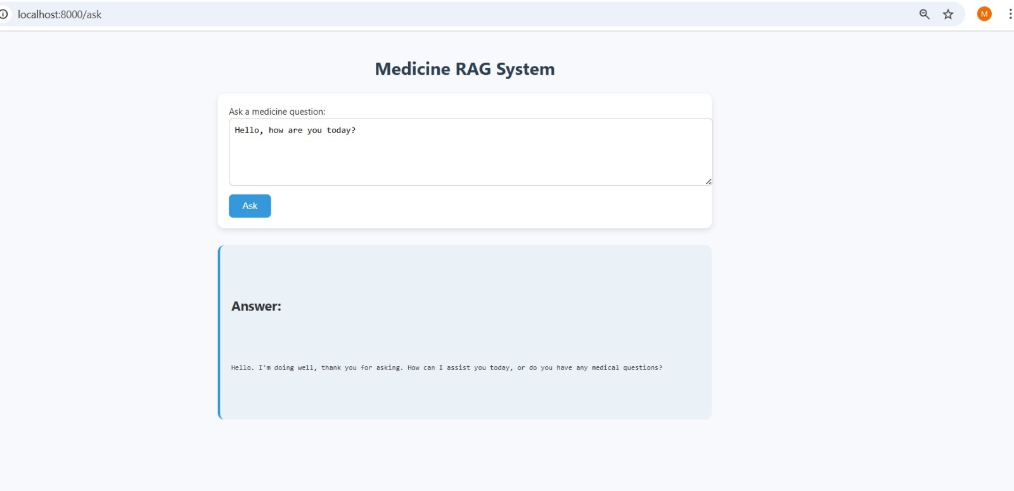
Output Example

Slide 12
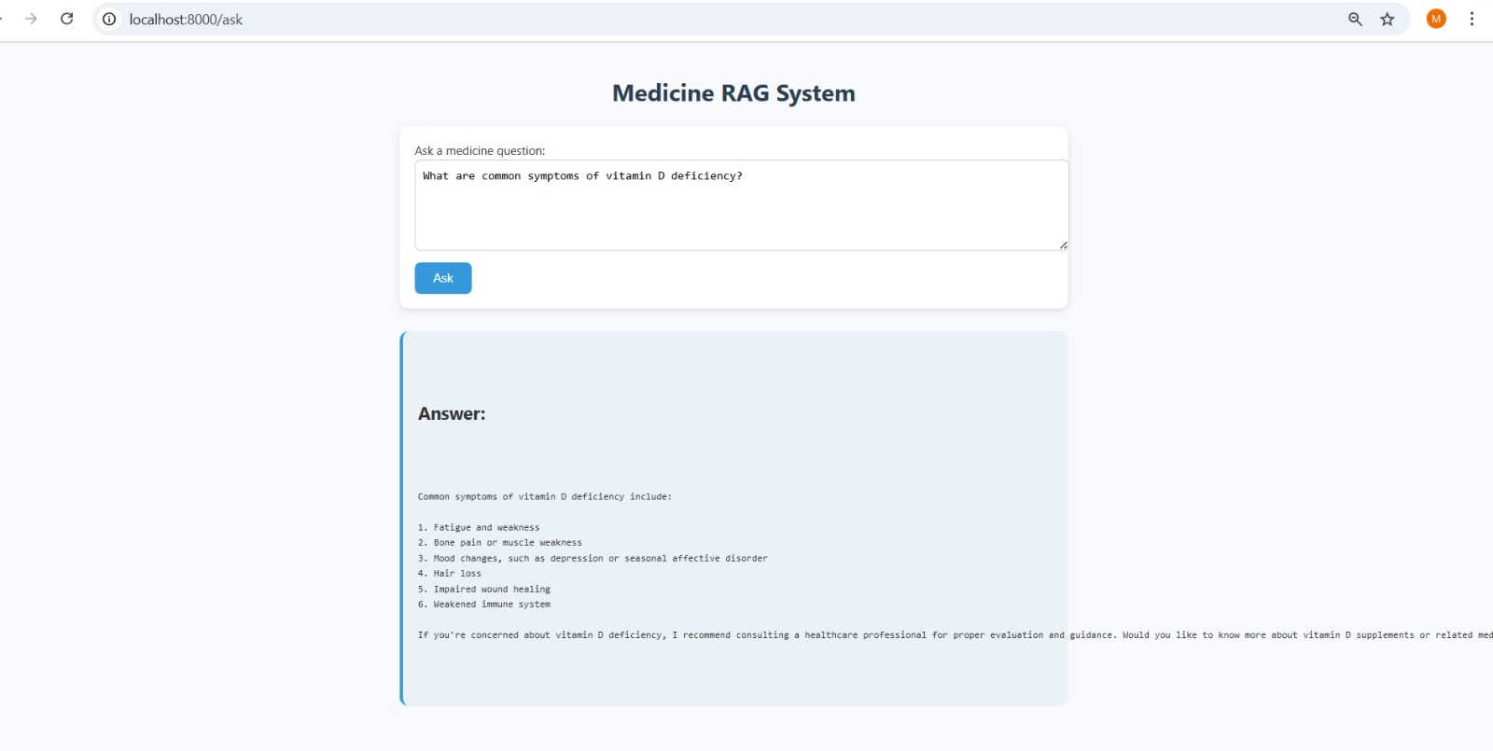

Slide 13
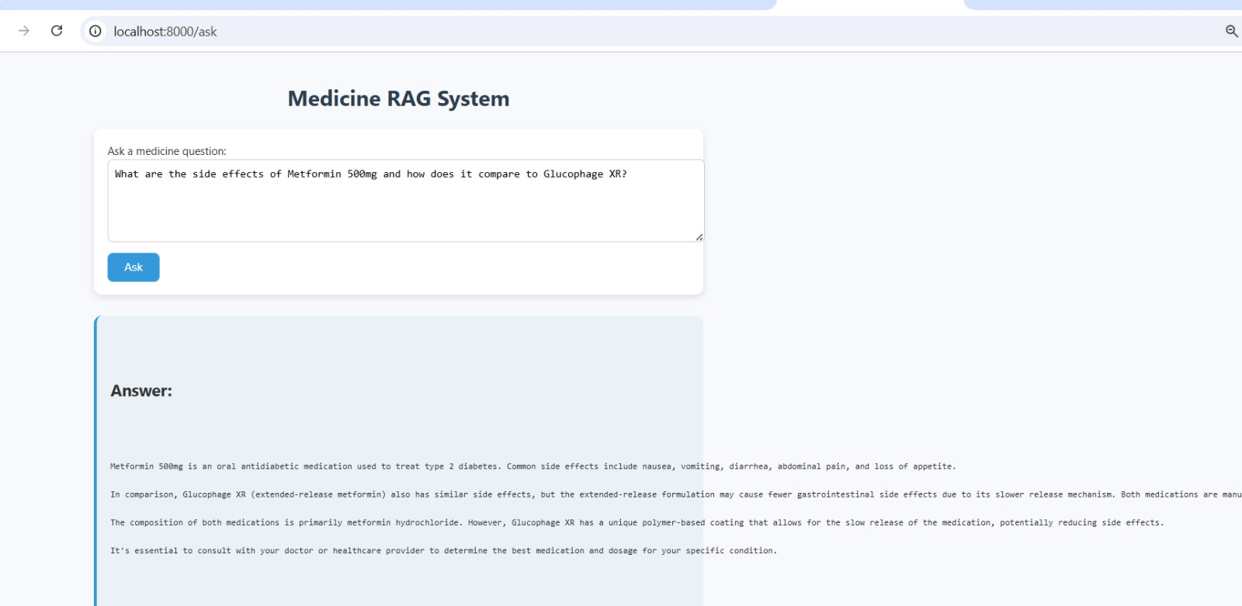

Slide 14
Future Enhancements
Multi-language support (Arabic / English).
Local Drugs Database.
Doctor-only extended knowledge (dosage, interactions).
User authentication.
Chat history memory.
Clinical trials integration.
Regulatory compliance (EU MDR, HIPAA, FDA).

Slide 15
Thank You

